Slide 1
The next slide will show the template document that the invoice generator will fill in on the left.
On the right is the folder where the project and template live currently to show that no “new” invoice has been generated.

Slide 2
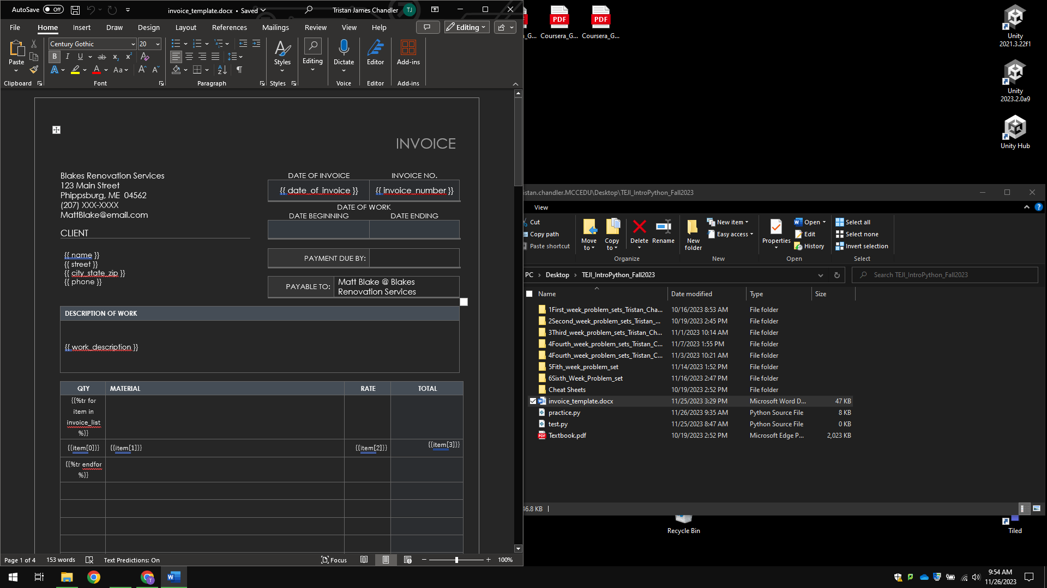

Slide 3
I open my code editor and keep the template on the left.
Both the template invoice document and “practice.py”, live in the same folder.

Slide 4
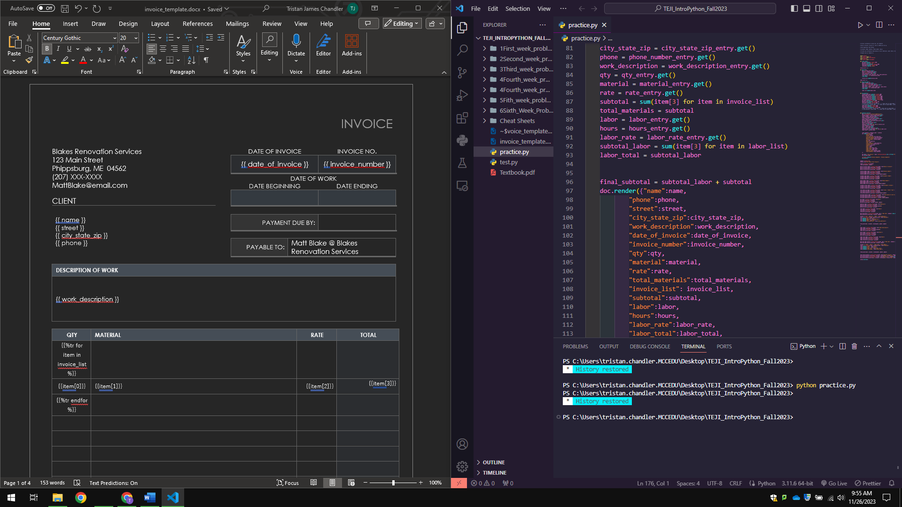

Slide 5
In the code editor I run in the terminal, “python practice.py” which runs the program thus opening the “GUI”.
In which you see displayed in the next slide.
(Graphical User Interface)

Slide 6
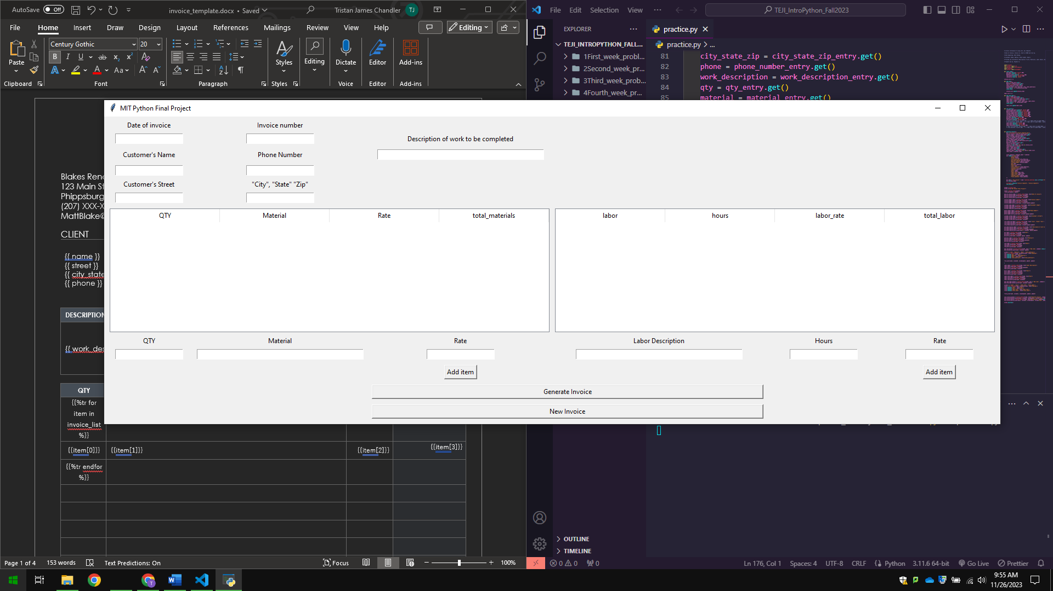

Slide 7
I fill in all the respective fields.

Slide 8
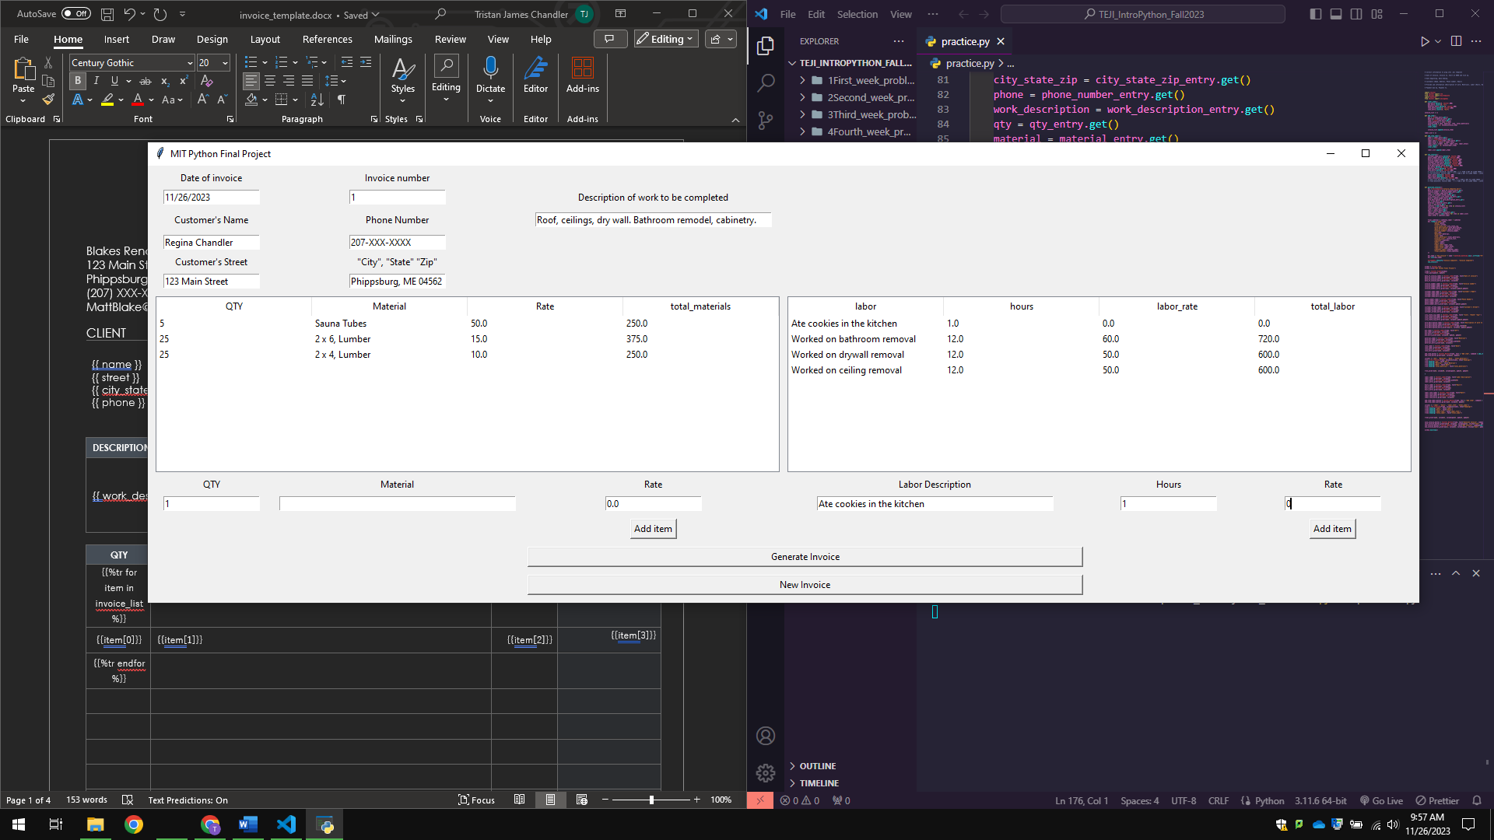

Slide 9
I click “Generate Invoice”.

Slide 10
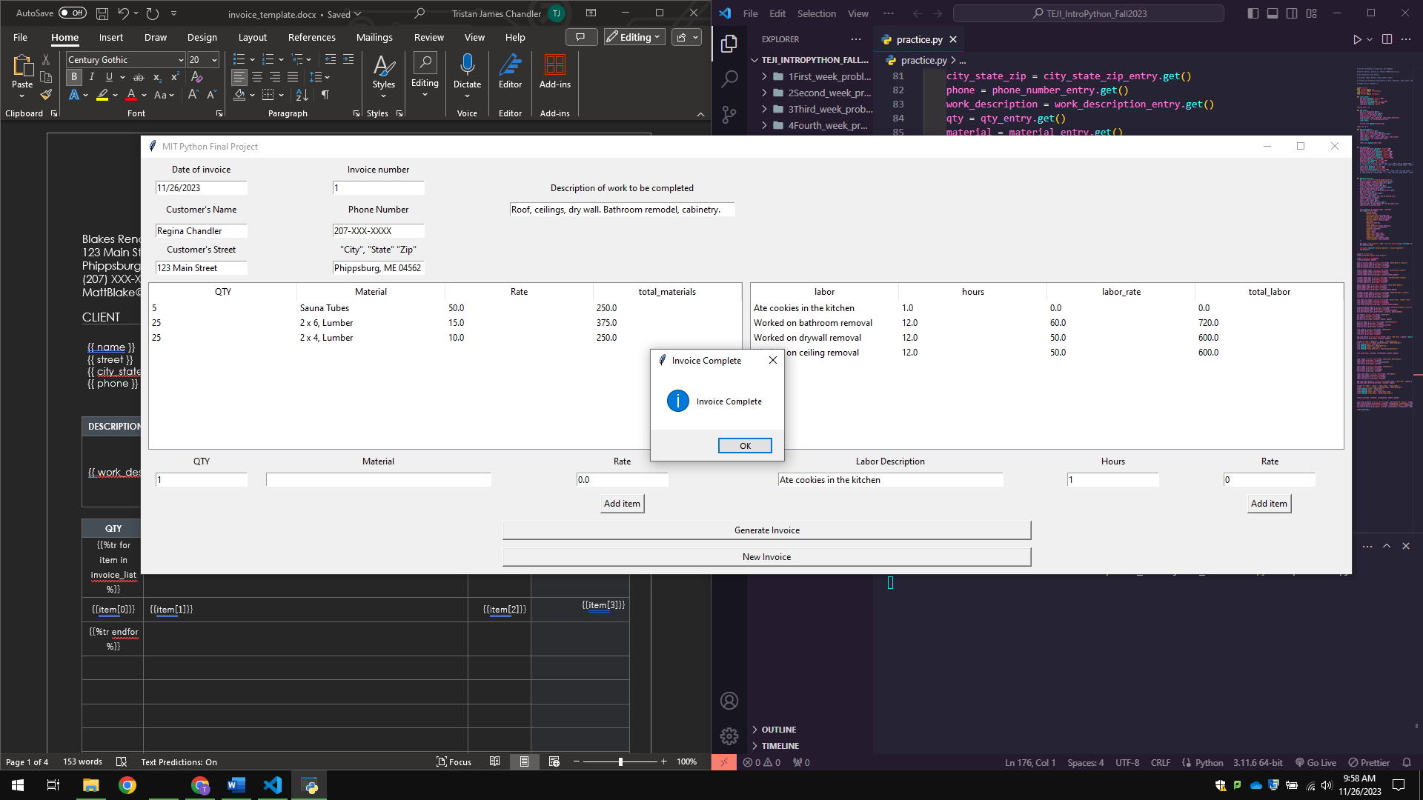

Slide 11
I return to the folder where both the program and invoice template live, and low and behold there is a new invoice generated.

Slide 12
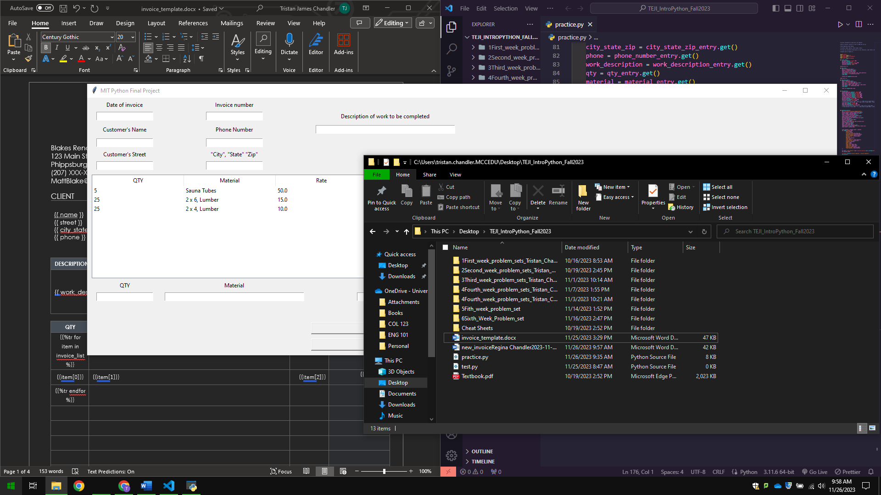

Slide 13
I open them side by side to see what has been changed.
On the left is the template we started with. On the right is the new invoice.

Slide 14
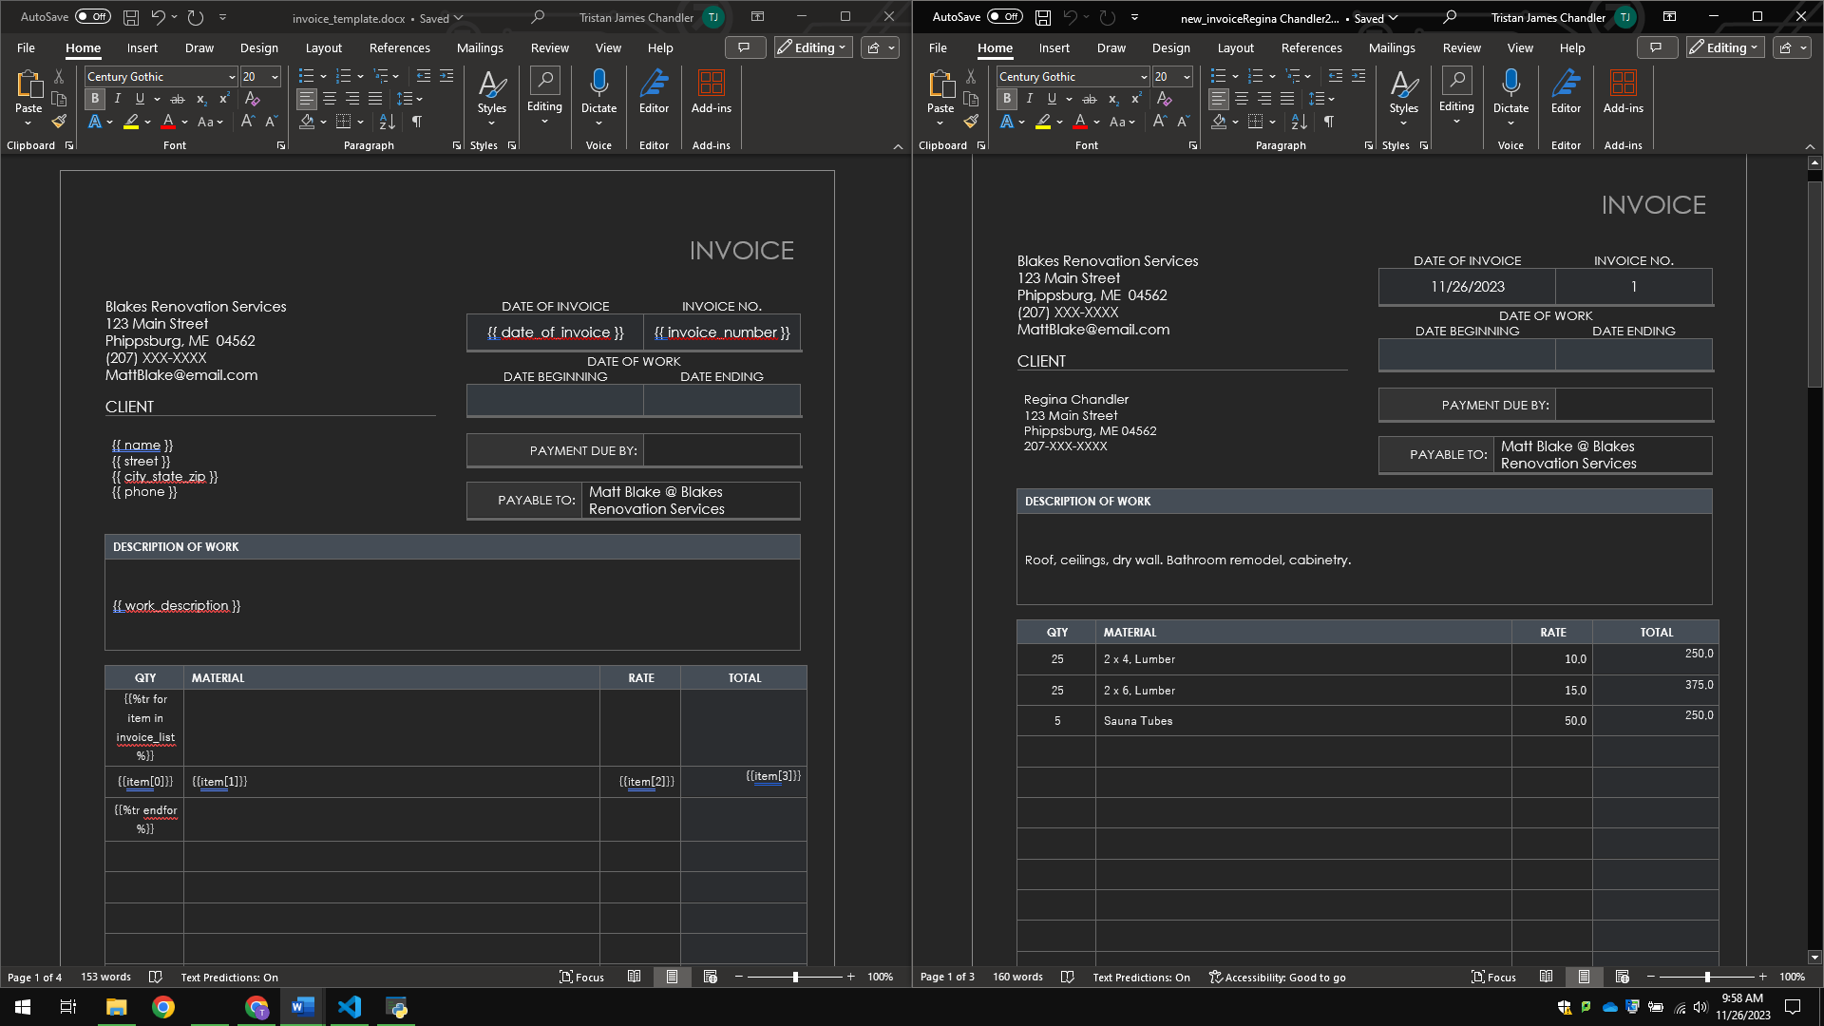

Slide 15
